Slide 1
01
“Digging Into Self-Supervised Monocular Depth Estimation”
INTRODUCTION
Per-pixel ground-truth depth data is challenging to acquire at scale. To overcome this limitation, self-supervised learning has emerged as a promising alternative for training models to perform monocular depth estimation. We proposed a set of improvements, which together result in both quantitatively and qualitatively improved depth maps compared to competing self-supervised methods. Research on self-supervised monocular training usually explores increasingly complex architectures, loss functions, and image formation models, all of which have recently helped to close the gap with fully-supervised methods. We show that a surprisingly simple model, and associated design choices, lead to superior predictions. In particular, we propose
A novel appearance matching loss to address the problem of occluded pixels that occur when using monocular supervision.
A novel and simple automasking approach to ignore pixels where no relative camera motion is observed in monocular training.
A multi-scale appearance matching loss that performs all image sampling at the input resolution, leading to a reduction in depth artifacts.
We demonstrate the effectiveness of each component in isolation, and show high quality, state-of-the-art results on the KITTI benchmark.

Slide 2
02
Previous Research Work
Supervised Depth Estimation:
Estimating depth from a single image is an inherently ill posed problem as the same input image can project to multiple plausible depths.
Many of the methods are fully supervised, requiring ground truth depth during training. Recent work has shown that conventional structure-from-motion (SfM) pipelines can generate sparse training signal for both camera pose and depth.
Self-supervised Depth Estimation:
In the absence of ground truth depth, one alternative is to train depth estimation models using image reconstruction as the supervisory signal.
Self -supervised Stereo Training:
synchronized stereo pairs are available during training, and by predicting the pixel disparities between the pair, a deep network can be trained to perform monocular depth estimation at test time.
Figure 1. Qualitative results. All methods were trained on KITTI using monocular supervision.

Slide 3
03
Continued..
Self-supervised Monocular Training:
In self-supervision, we use monocular videos, where consecutive temporal frames provide the training signal. Here, in addition to predicting depth, the network has to also estimate the camera pose between frames, which is challenging in the presence of object motion. This estimated camera pose is only needed during training to help constrain the depth estimation network
Appearance Based Losses:
Self-supervised training makes assumptions about the appearance and material properties of objects. Including a local structure-based appearance loss improves depth estimation performance.
Figure 1. Qualitative results. All methods were trained on KITTI using monocular supervision.

Slide 4
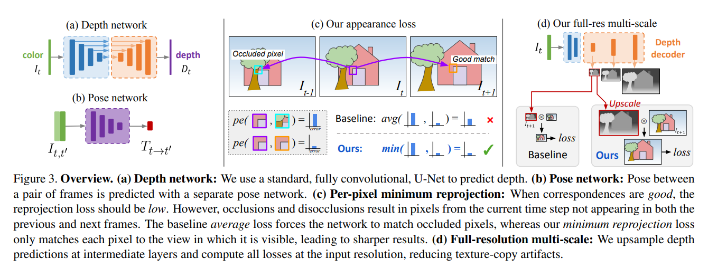
04
Methodology
we describe our depth prediction network that takes a single color input It and produces a depth map Dt. We first review the key ideas behind self-supervised training for monocular depth estimation, and then describe our depth estimation network and joint training loss.
Self-Supervised Training
Improved Self-Supervised Depth Estimation

Slide 5
05
Methodology
Self-Supervised Training:
By constraining the network to perform image synthesis using an intermediary variable, in our case depth or disparity, we can then extract this interpretable depth from the model. This is an ill-posed problem as there is an extremely large number of possible incorrect depths per pixel which can correctly reconstruct the novel view given the relative pose between those two views. we formulate our problem as the minimization of a photometric reprojection error at training time. We express the relative pose for each source view I_{t’} , with respect to the target image I_{t’}s pose, as T_{t→t’} . We predict a dense depth map D_{t} that minimizes the photometric reprojection error L_{p}, where
Improved Self-Supervised Depth Estimation:
Existing monocular methods produce lower quality depths than the best fully-supervised models
Per-Pixel Minimum Reprojection Loss We propose an improvement to self-supervised depth estimation methods that addresses the issues caused by averaging reprojection error into each source image. This improvement handles both out-of-view pixels and occluded pixels, which can lead to high photometric error penalties. our proposed improvement addresses both out-of-view pixels and occluded pixels by using the minimum photometric error instead of averaging it over all source images. This approach reduces artifacts at image borders, improves the sharpness of occlusion boundaries, and leads to better accuracy.

Slide 6
05
Methodology
Auto-Masking Stationary Pixels To address performance degradation when assumptions of a moving camera and static scene break down in self-supervised monocular training, we propose a simple auto-masking method. This method filters out pixels that do not change appearance from one frame to the next in the sequence. By automatically computing a binary mask on the forward pass of the network, we can effectively ignore objects that move at the same velocity as the camera or even whole frames in monocular videos when the camera is stationary. This approach improves the accuracy of depth maps by preventing "holes" of infinite depth in predicted results.
Multi-scale Estimation In order to address the issues of "holes" in low-texture regions and texture-copy artifacts in intermediate depth maps, we propose an improvement to the multi-scale formulation. We decouple the resolutions of the disparity images and color images used for computing the reprojection error. By upsampling the lower-resolution depth maps to the input image resolution, we ensure that the error is computed at a higher resolution. This approach helps constrain the depth maps at each scale to work towards accurately reconstructing the high-resolution input target image, improving depth prediction accuracy and reducing artifacts.
Final Training Loss We combine our per-pixel smoothness and masked photometric losses as
L = µLp + λLs,
and average over each pixel, scale, and batch

Slide 7
03
Experimental design
Here, we validate that
our reprojection loss helps with occluded pixels compared to existing pixel-averaging
our auto-masking improves results, especially when training on scenes with static cameras
our multi-scale appearance matching loss improves accuracy.
We follow previous work in initializing our encoders with weights pretrained on ImageNet . While some other monocular depth prediction works have elected not to use ImageNet pretraining, we found that even without pretraining, we still achieve state-of-the-art results. We train these ‘w/o pretraining’ models for 30 epochs to ensure convergence. We also found that, the benefit our contributions bring both to pretrained networks and those trained from scratch.
We evaluate our models, named Monodepth2, on the KITTI 2015 stereo dataset, to allow comparison with previously published monocular methods

Slide 8
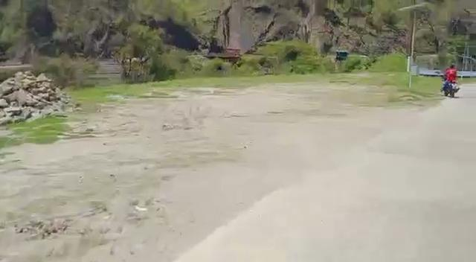
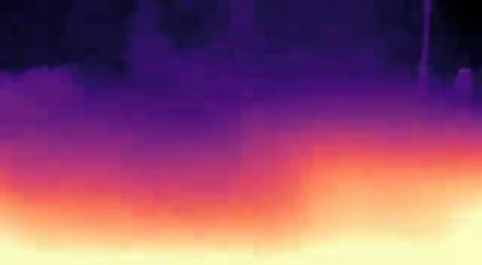
03
Results
Input dataset b) Resultant output
Figure 2. Results on our college Dataset. Our model perform sharpest depth map relatively.a) we perform testing of the model on our college dataset b) Depth estimation resultant output from the monocular frame

Slide 9
03
Conclusion
We have presented a versatile model for self-supervised monocular depth estimation, achieving state-of-the-art depth predictions. We introduced three contributions:
(i) a minimum reprojection loss, computed for each pixel, to deal with occlusions between frames in monocular video
(ii) an auto-masking loss to ignore confusing, stationary pixels, and
(iii) a full-resolution multi-scale sampling method. We showed how together they give a simple and efficient model for depth estimation, which can be trained with monocular video data, stereo data, or mixed monocular and stereo data.

Slide 10
03
Contribution
Shashank Kapoor
Literature Review.
Pretraining of the model and testing on our dataset.
Report and Presentation write up.
Syed Rizwan Ali Quadri
ds
Shubham Patwar

Slide 11
03
References
1.Clement Godard et. al. Digging Into Self-Supervised Monocular Depth Estimation. CVPR August 2019.

Slide 12
Any suggestion?
To extend the idea in future work

Slide 13
Thank you!

